Slide 1
Finding a Better Neighborhood to live in Scarborough, Toronto

Slide 2
Motivation
The motive of this Project is to assist people in exploring facilities around their neighborhood.
It will assist people making smart and efficient choice on choosing a neighborhood out of numbers of different neighborhoods in Scarborough, Toranto.
This Project aim to create an analysis of features for a people migrating to Scarborough to search a best neighborhood as a comparative analysis between neighborhoods.
The features include median housing price and better school according to ratings, crime rates of that particular area, road connectivity, weather conditions, good management for emergency, water resources both fresh and waste water and excrement conveyed in sewers and recreational facilities.

Slide 3
Data Extraction and Cleaning
We will use Scarborough dataset which we scrapped from wikipedia on Week 3. Dataset consisting of latitude and longitude, zip codes.
Data link:
https://en.wikipedia.org/wiki/List_of_postal_codes_of_Canada:_M
We will need data about different venues in different neighborhoods of that specific borough. In order to gain that information we will use "Foursquare" locational information.
Foursquare is a location data provider with information about all manner of venues and events within an area of interest. Such information includes venue names, locations, menus and even photos. As such, the foursquare location platform will be used as the sole data source since all the stated required information can be obtained through the API.

Slide 4
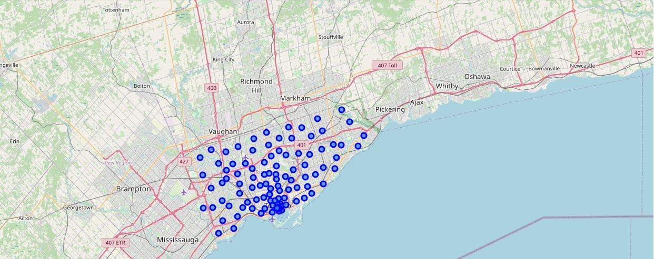
Map of Scarborough

Slide 5
Methodology and Workflow
To compare the similarities of two cities, we decided to explore neighborhoods, segment them, and group them into clusters to find similar neighborhoods in a big city like New York and Toronto. To be able to do that, we need to cluster data which is a form of unsupervised machine learning: k-means clustering algorithm.
Using credentials of Foursquare API features of near-by places of the neighborhoods would be mined. Due to http request limitations the number of places per neighborhood parameter would reasonably be set to 100 and the radius parameter would be set to 500.

Slide 6
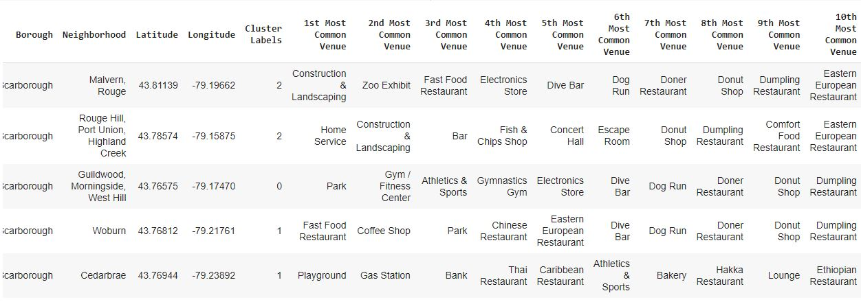
Using K-Means Clustering Approach

Slide 7
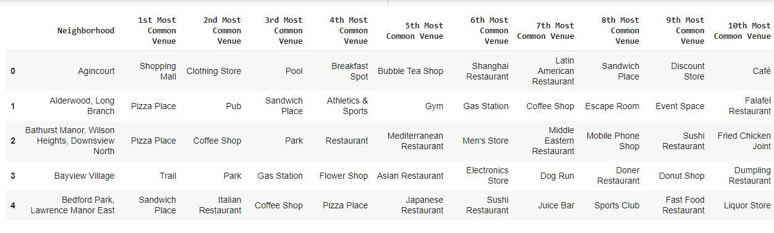
Most Common venues near Neighborhood

Slide 8
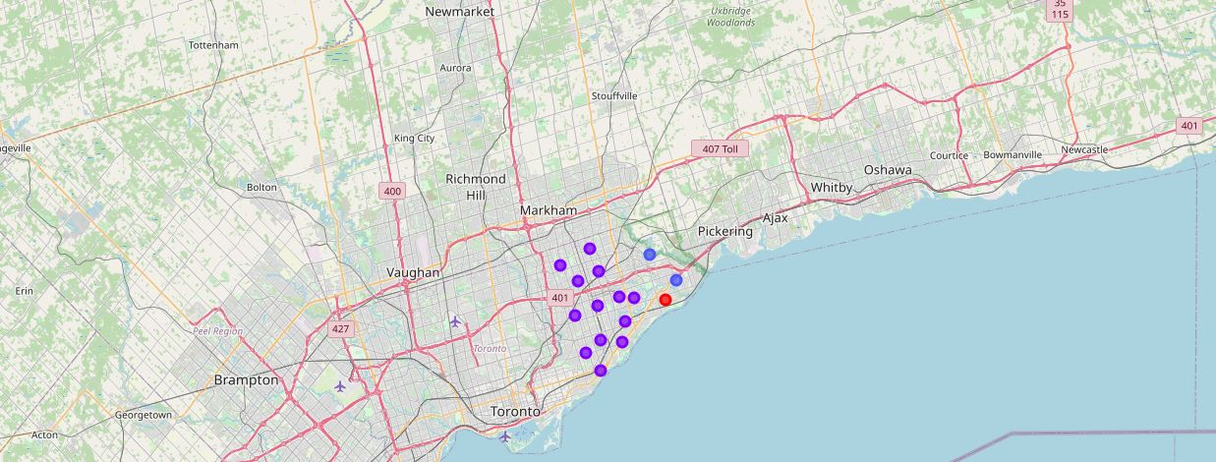
Map of Clusters in Scarborough

Slide 9
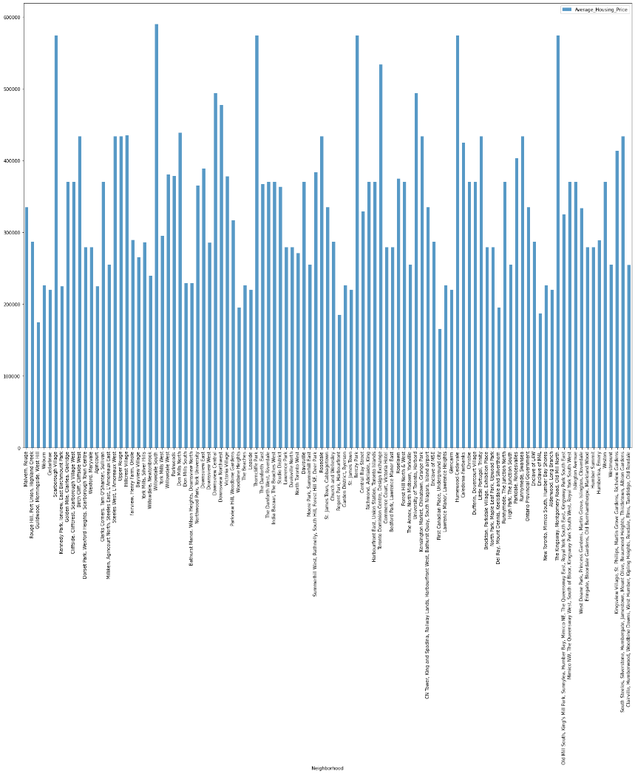
Average Housing Price by Clusters in Scarborough

Slide 10
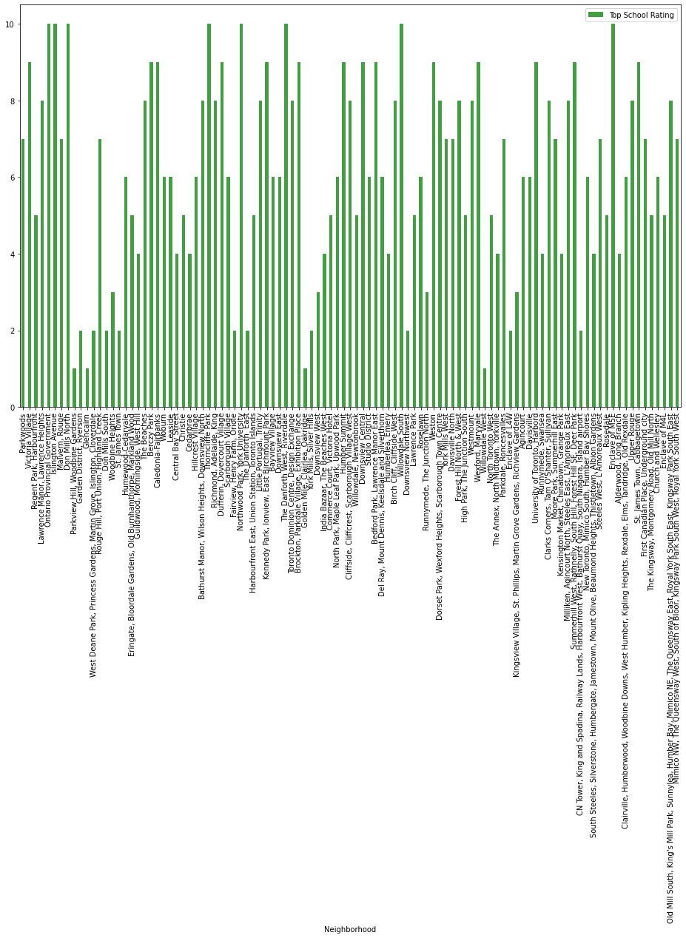
School Ratings by Clusters in Scarborough

Slide 11
Conclusion
In this project, using k-means cluster algorithm I separated the neighborhood into 10(Ten) different clusters and for 103 different lattitude and logitude from dataset, which have very-similar neighborhoods around them. Using the charts above results presented to a particular neighborhood based on average house prices and school rating have been made.

